Slide 1
CODEBOOK
WQD7001

Slide 2
Learning Objectives:
What is a codebook and why create one.
Tools available to create a codebook.
Creating the codebook using standard R API functionality.
Manually create a custom codebook.

Slide 3
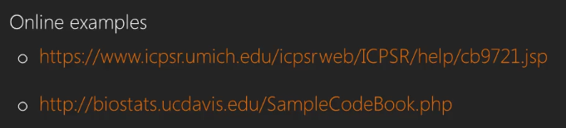
1. What is a codebook and why create one?
What a codebook is and why it is important
An important document for research or data analysis.
Provides data on variables coding and database generation.
Provide details of the data and where it was sourced.
Provide a reference for the research or analysis many years later.

Slide 4
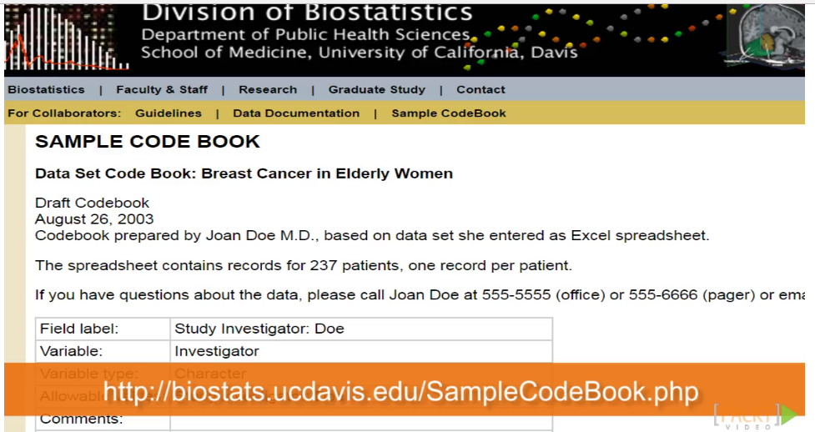

Slide 5
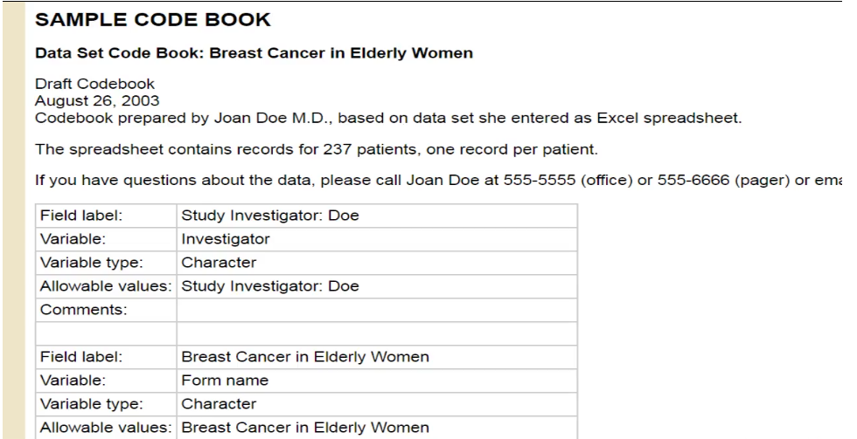
What goes into the codebook?

Slide 6
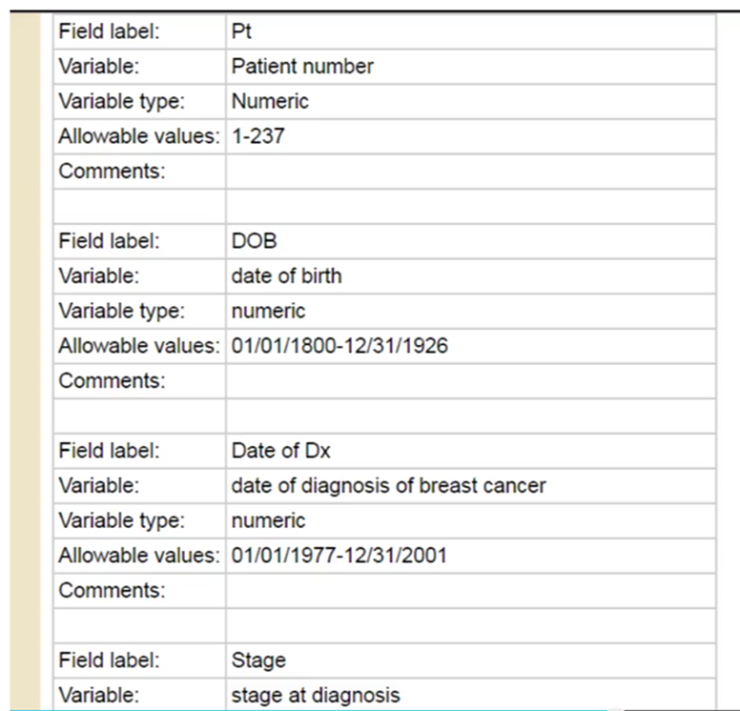
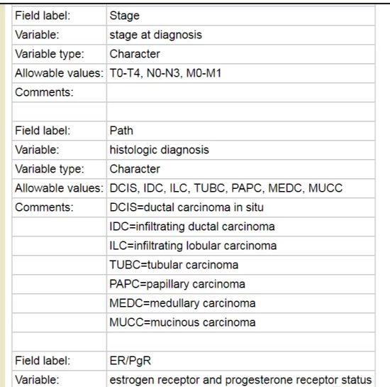
Metadata

Slide 7
The use of variables and metadata
Metadata
Variables
The data collection process
The date the data was collected
List of the areas covered by the dataset
Number of cases or population size
Geographic region of the dataset
The date the data was cleaned and by whom.
Storage location -The full path and file names that make up the dataset.
Measures used to collect the data must be detailed
Survey questions must be listed along with associated codes
Details on how missing data is handled must be described
The name of each variable
The type of data associated with a variable (i.e. String, date, float and number)

Slide 8
2 (a) Creating the codebook using standard R API functionality
In R Studio, try this:
Accessing supplied datasets within R Studio
Using the memisc codebook function
Using the summary function
> install.packages("memisc")
> library (memisc)
> x <- data.set(Orange) # cast the data to R dataset
> typeof (x)
[1] "list"
> x
Tree age circumference
1 1 118 30
2 1 484 58
3 1 664 87
4 1 1004 115
1 1231 120
> codebook (x) #call the codebook function
> summary (x)
List the datasets available in R, type:
> data ()

Slide 9
2 (b) Manually create a custom codebook.
Using the class function to determine the data type.
Using the sapply function to extract more details.
Using the Orange dataset supplied with R studio.
Try the following:
> x <- data.set(Orange)
> class (Orange)
[1] "nfnGroupedData" "nfGroupedData" "groupedData" "data.frame"
> sapply(Orange,class)
$Tree
[1] "ordered" "factor"
$age
[1] "numeric"
$circumference
[1] "numeric"

Slide 10
sapply ()
> sapply (Orange, min)
Tree age circumference
1 118 30
> sapply (Orange, max)
Tree age circumference
5 1582 214
> sapply (Orange, range)
Tree age circumference
[1,] 1 118 30
[2,] 5 1582 214
> summary (Orange)
Tree age circumference
3:7 Min. : 118.0 Min. : 30.0
1:7 1st Qu.: 484.0 1st Qu.: 65.5
5:7 Median :1004.0 Median :115.0
2:7 Mean : 922.1 Mean :115.9
4:7 3rd Qu.:1372.0 3rd Qu.:161.5
Max. :1582.0 Max. :214.0

Slide 11
Create your codebook
Now based on what you have learnt in this tutorial.
Choose any dataset available in R Studio and create a codebook using the methods presented in this tutorial.
Briefly, explain what is presented.
Submit on Spectrum before you leave the tutorial session.

